Slide 1


FUFO Project
Final Report

Slide 2

Contents
1
Introduction
2
Hardware & Software
3
Algorithms
4
Experiments and results
5
Conclusion

Slide 3
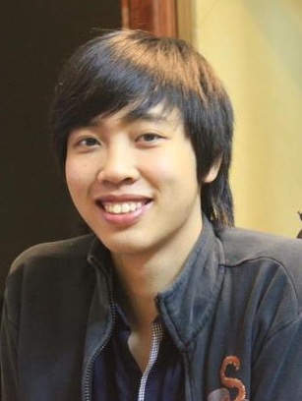





FUFO team
Introduction
PhongVM
ThangVD
HungPD Supervisor
NguyenLK
HungHD
YenTT

Slide 4
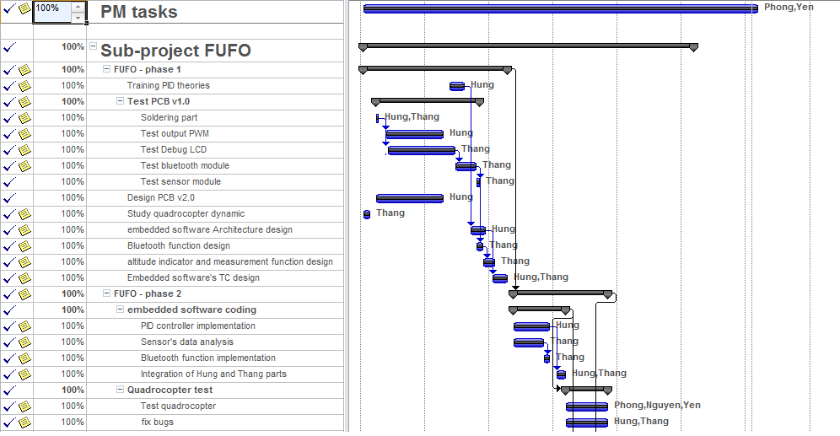
Project Plan
Introduction

Slide 5
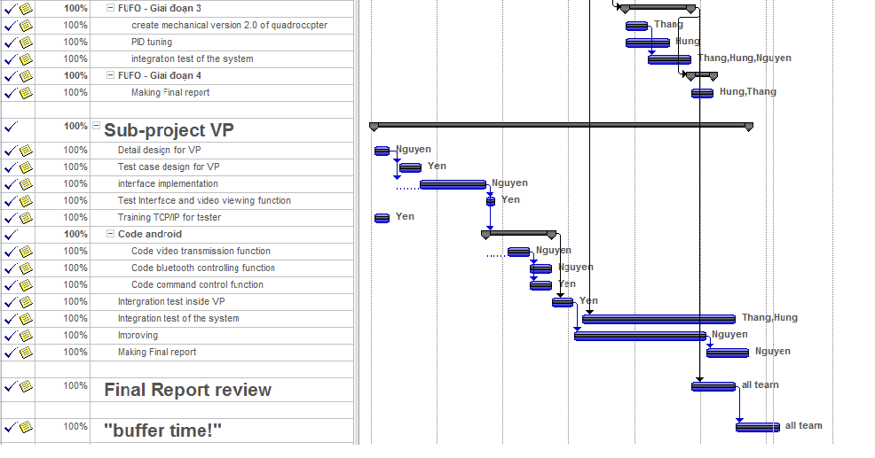
Project Plan
Introduction

Slide 6
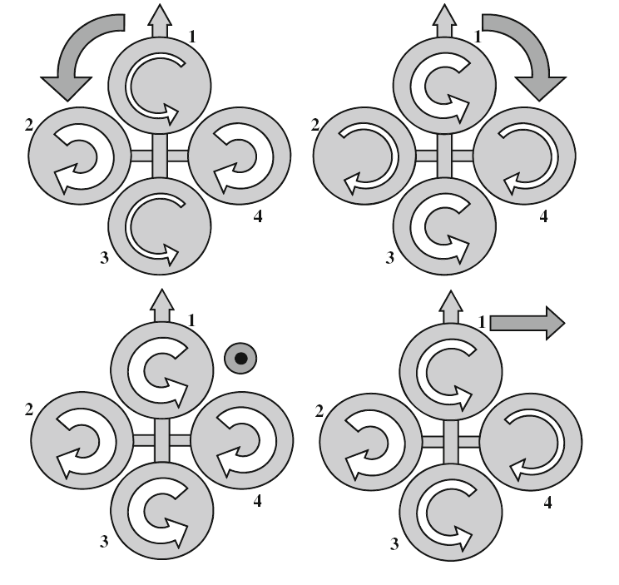
History
Introduction
Definition:
A Vertical Take-Off and Landing aircraft.
Has 4 rotors.

Slide 7
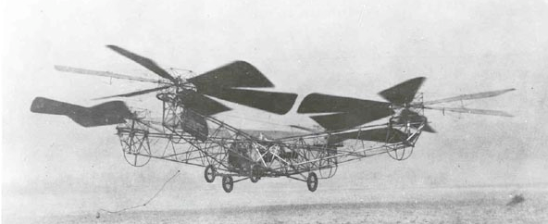
History
Introduction
The first Quadrocopter was developed in 1920.
No commercialized Quadrocopter because of limitation of technology and science at that time.

Slide 8
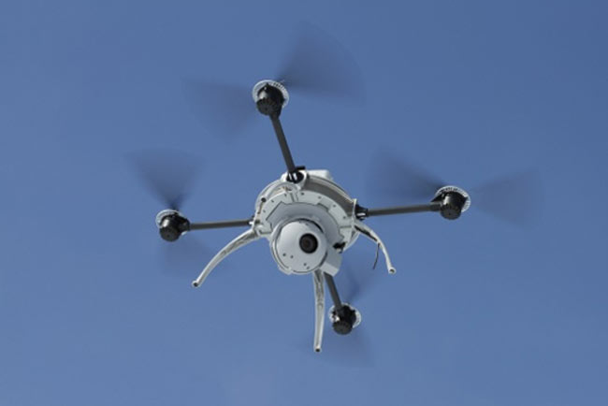
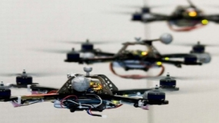
History
Introduction
8 years before 2012, many institutes and companies began to research on this platform as a small UAV.

Slide 9
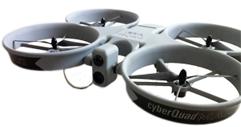
Commercialized product
Introduction
Airbot X600-BKPP (€ 34,500)
Radio control unit (2.4 GHz)
Live video stream
GPS waypoint navigation
CyberQuad Maxi ($ 36,000)
Radio control unit
GPS waypoint navigation
Live video stream

Slide 10
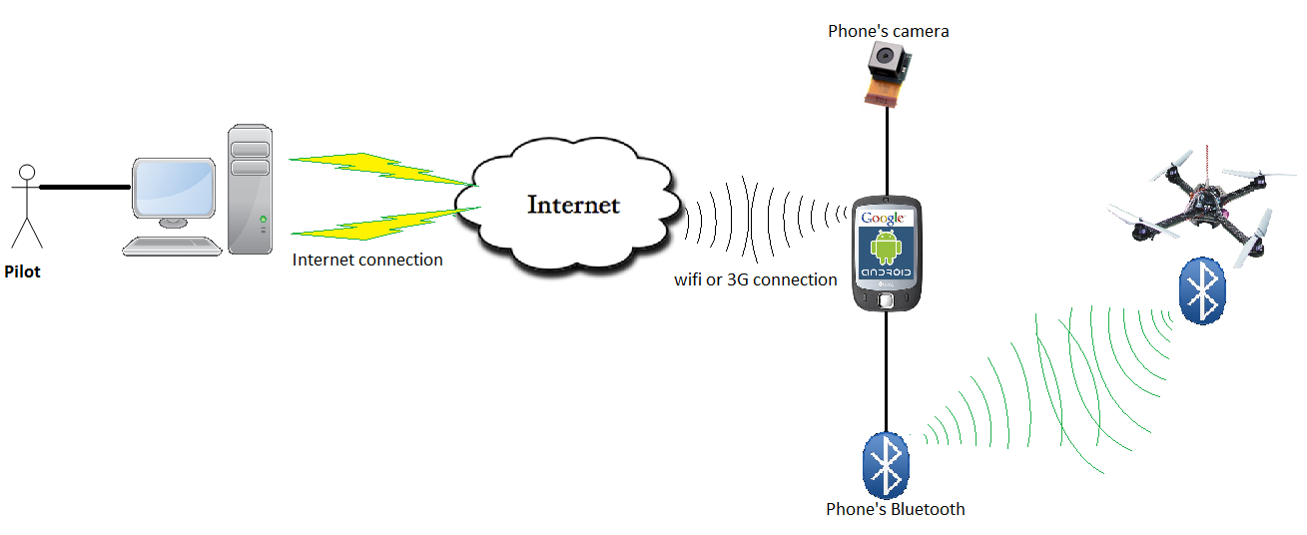
Idea
Introduction
Develop a Quadrocopter for observation purpose.

Slide 11
Idea
Introduction
Why choosing Quadrocopter platform?
 | Quadrocopter | Helicopter | Fixed-Wing aircraft
Aerodynamics mechanical design | Medium | Complicated | Complicated
Control method | Medium | Medium | Complicated
Runway | No | No | Yes
➔ Quadrocopter is more suitable for embedded Engineering students who are not familiar with aerospace issue and mechanical design.

Slide 12
Idea
Introduction
Why choosing Android Phone?
 | Android phone | In-circuit designs
Software development | Android SDK | Linux, C30…
Evaluation of controlling by phone/tablet via Bluetooth? | Yes | No
Risk and complexity in hardware design | Low | High
Cost | Low | High
Has built-in camera, Wi-Fi, 3G module
Phone is still usable after this Capstone project

Slide 13
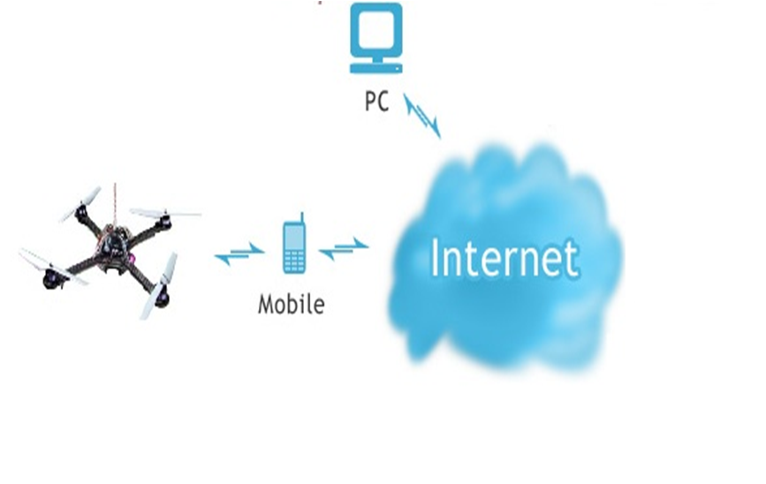
Idea
Introduction
Command
Sensor data
Bluetooth

Slide 14
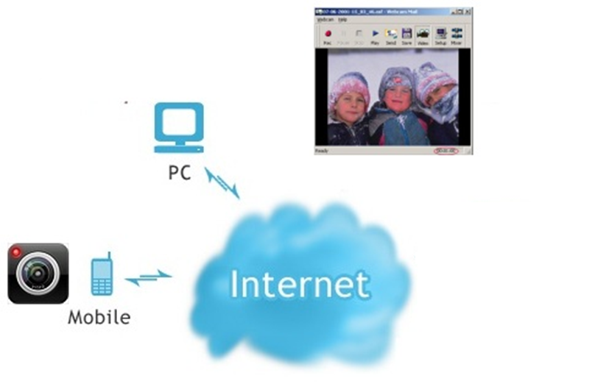
Idea
Introduction
Picture
Picture
JPEG
JPEG

Slide 15
Idea
Introduction
Control Mode
Autonomous(Dynamic Stabilization)
Manual

Slide 16
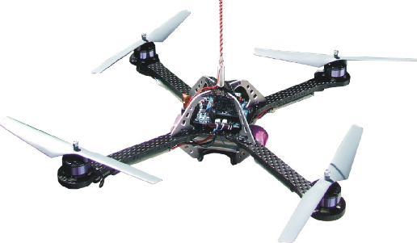
Idea
Introduction
Wind
Manual mode

Slide 17
Idea
Introduction
Dynamic stabilization
Wind
Dynamic Stablization
SAFE
Go to 1m

Slide 18
Hardware study
Hard & Soft
No. | Components | Quantity | Description
1 | dsPIC30f4012 | 1 | Microcontroller
2 | HC-06 | 1 | Bluetooth module
3 | BMP085 | 1 | Barometer
4 | L3G4200D | 1 | Gyroscope
5 | ADXL345 | 1 | Accelerometer
6 | HW 30A ESC | 4 | Electronic speed Controller
7 | Himodel 2212 1400kv | 4 | Brushless motor
8 | Turnigy 3000mAh 11.1v 3s | 2 | Li-Po battery pack.
9 | HTC HD2 | 1 | Android 2.3 phone

Slide 19
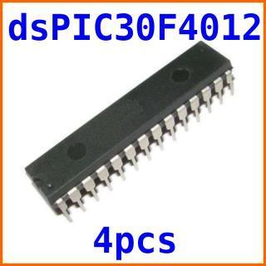
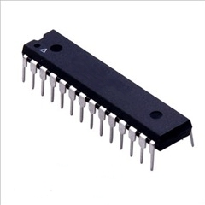
Hardware study
Hard & Soft
dsPIC30f4012 Microcontroller
Max speed: 30 MIPS
16x16 bit working arrays
5 timers, 3 PWM generators
Programmable by C30.

Slide 20
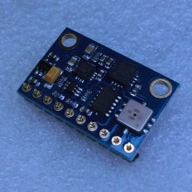
Hardware study
Hard & Soft
BMP085 + ADX345 + L3G4200D
All-in-one module:
3-axis accelerometer.
3-axis gyroscope.
-300m to 9000m altimeter.

Slide 21
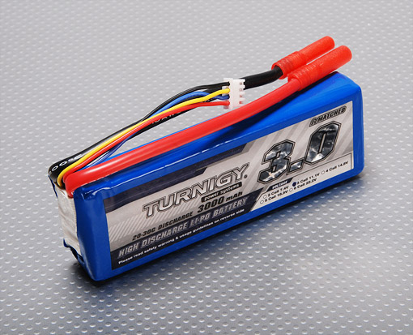
Hardware study
Hard & Soft
Turnigy 3000mAh battery pack
3000mAh x 2
253 grams x 2
11.1v
Discharge rate: 20C

Slide 22
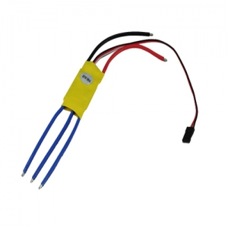
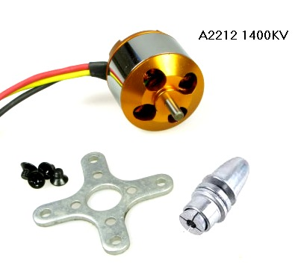
Hardware study
Hard & Soft
Motor and ESC
1400kv Brushless motors
8x4” propellers
ESC PWM range: 1ms – 2ms

Slide 23

Hardware study
Hard & Soft
HTC HD2 Android 2.3
320x240 camera.
Has Bluetooth and Wi-Fi connection
Run on Android 2.3

Slide 24
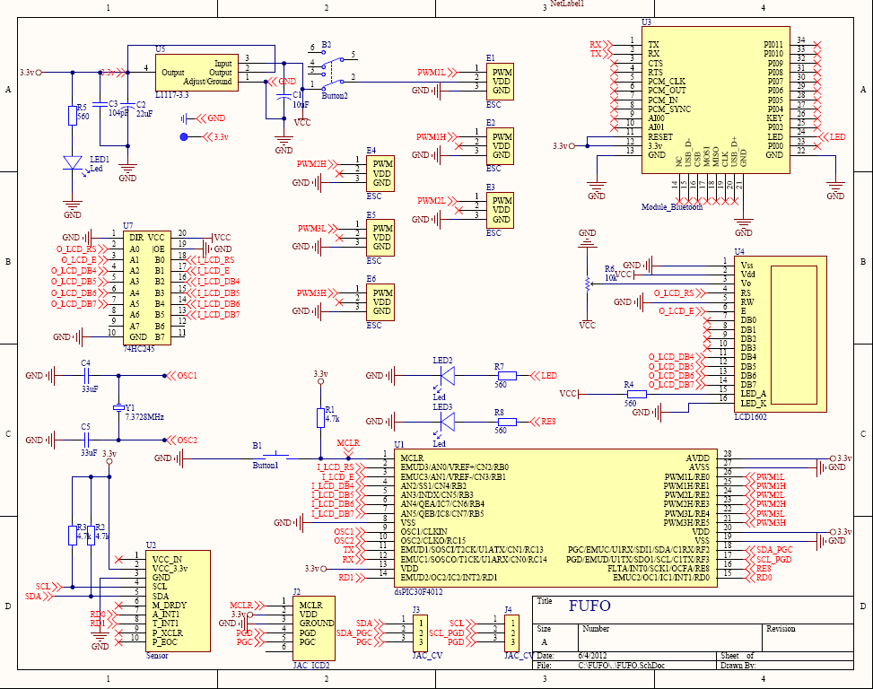
Hardware design
Hard & Soft

Slide 25
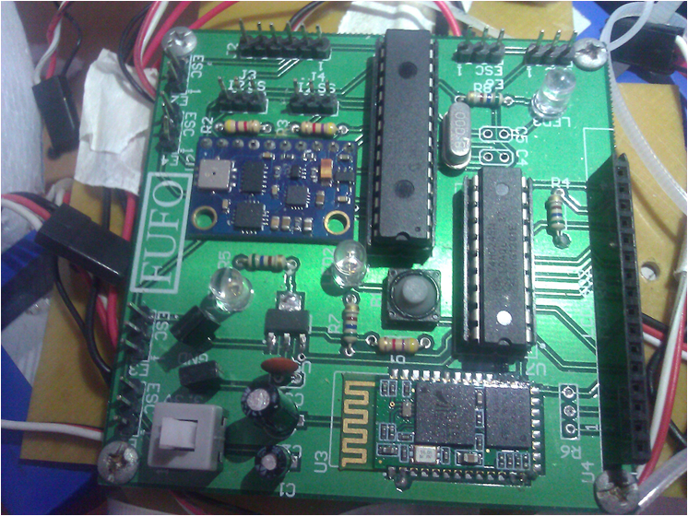
Hardware design
Hard & Soft

Slide 26
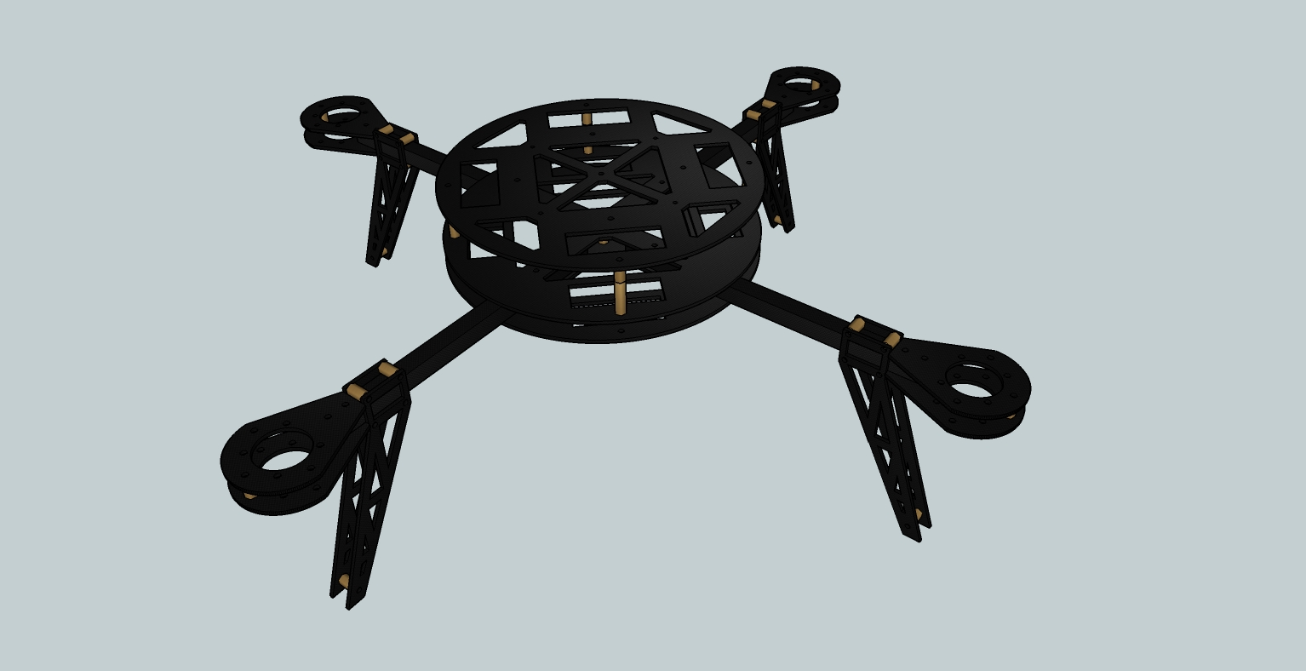
Frame design
Hard & Soft
Circuit mount
440 mm
Motor mount
Fiber Glass & Fiber Carbon

Slide 27
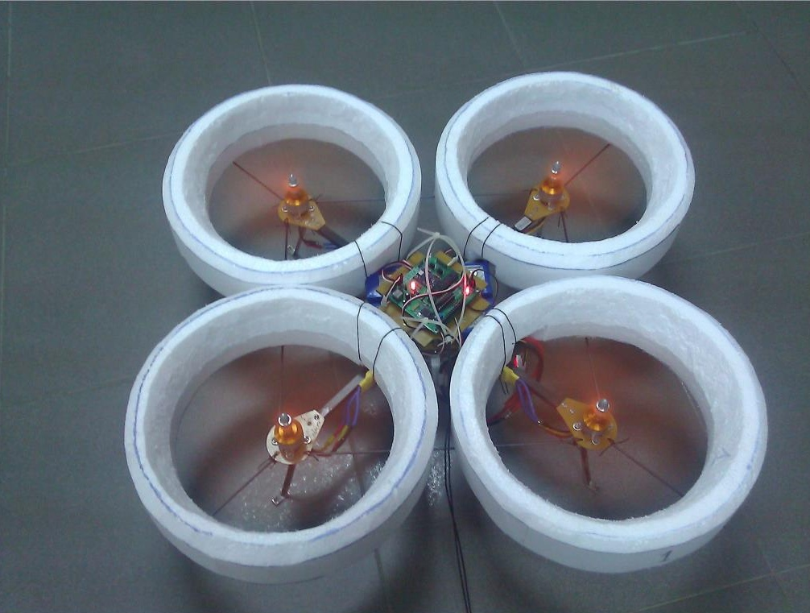
FUFO Quadrocopter
Hard & Soft

Slide 28
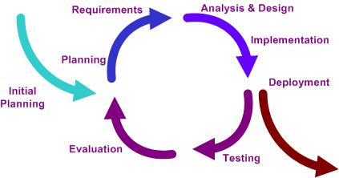
Software study
Hard & Soft
Iterative model:

Slide 29
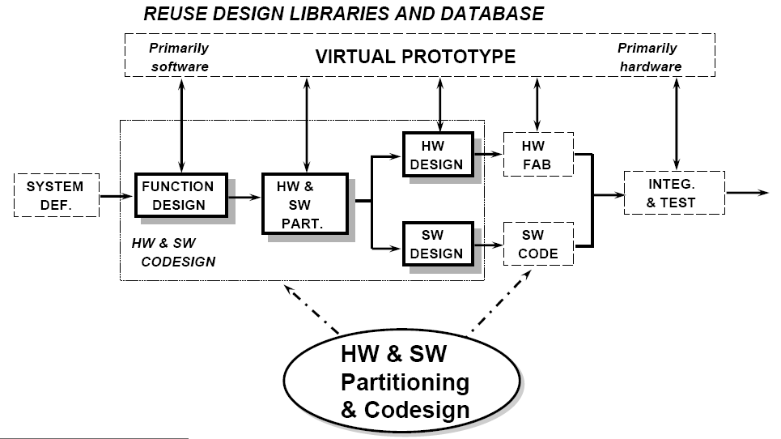
Software study
Hard & Soft
Embedded system development:

Slide 30
Software study
Hard & Soft
Three software:
Software on PC
Software on Phone
Firmware

Slide 31
Software study
Hard & Soft
FSM:
System initiated
System connected
WaitingForConnection
Start
Verify
Power on
Control
method
selected
Sensor data
initiated
Start button
pressed
Ready
SetupForFlight
Pending
First altitude
is chosen
Any error
Hovering
Error
Altitude is
set to zero
Landing
Motor stopped

Slide 32
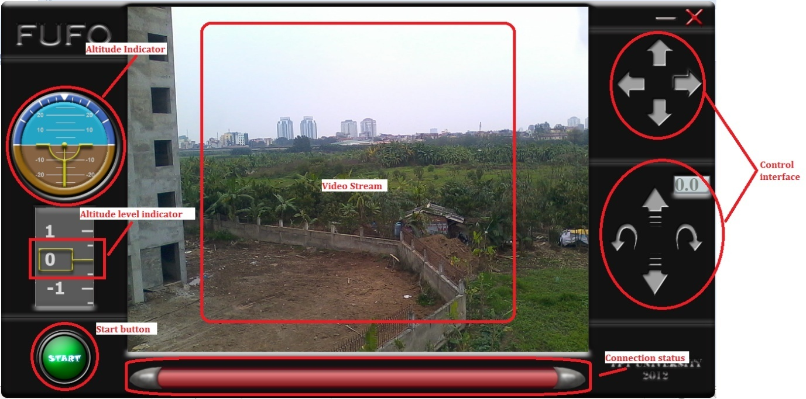
Software study
Hard & Soft
PC interface:

Slide 33
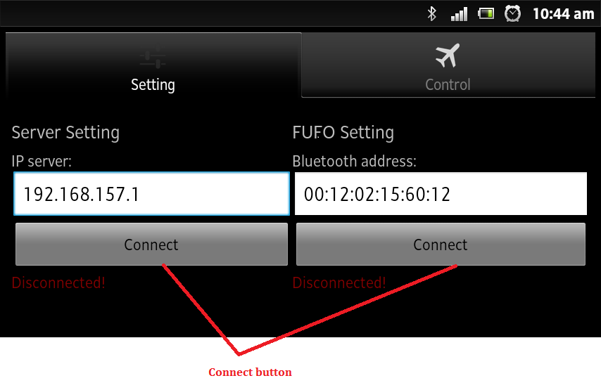
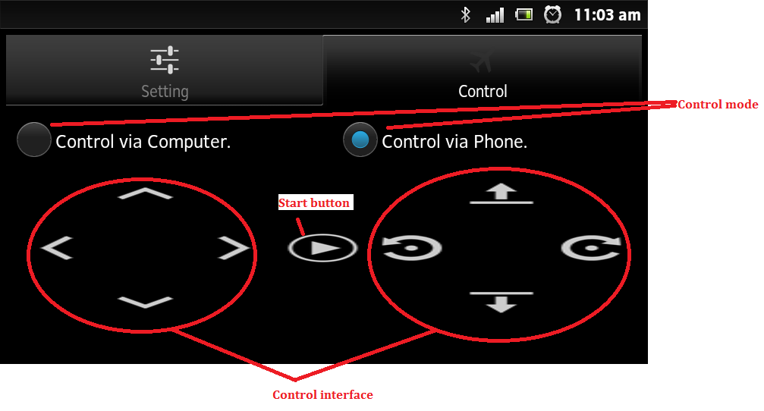
Software study
Hard & Soft
Android interface:

Slide 34
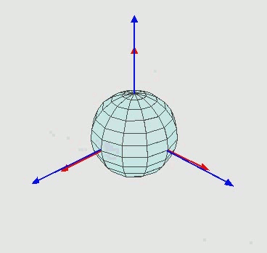
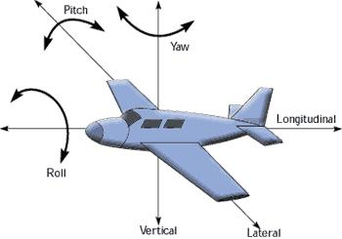
Quadrocopter Dynamic
Algorithms
Inertial Frame, Body frame and Euler Angle:

Slide 35
Quadrocopter Dynamic
Algorithms
Input:
𝜂₁ = [x,y,z];
𝜂₂ = [𝜃,𝜑,𝜓];
x = y = 0.
Output:
[F₁,F₂,F₃,F₄]
Linear translational movement
Rotational movement

Slide 36
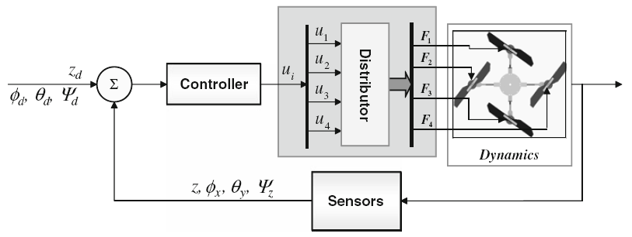
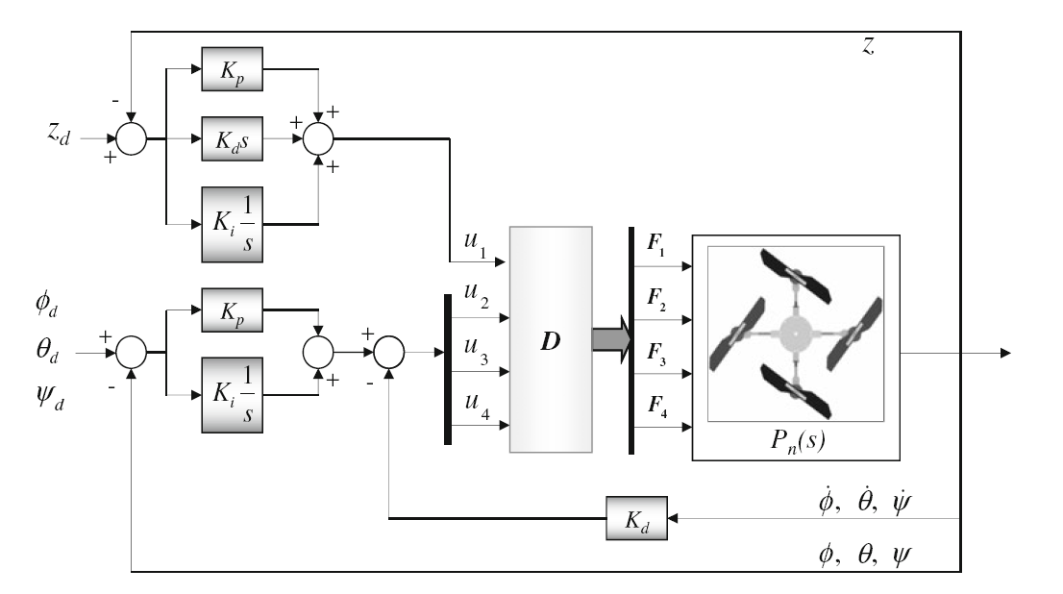
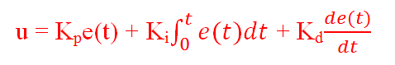
PID Control system
Algorithms
Open-loop feedback controller:

Slide 37
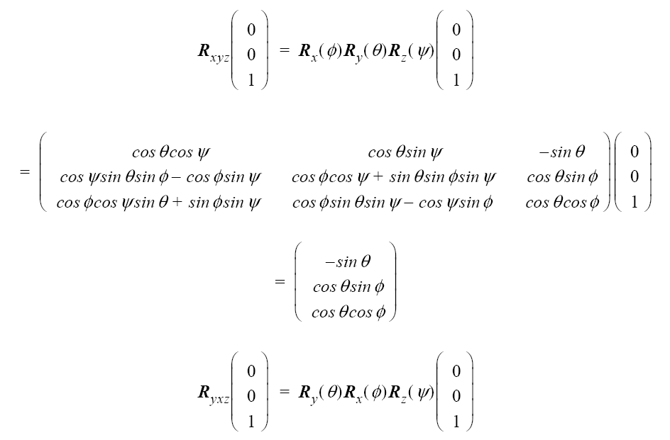
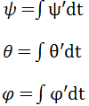
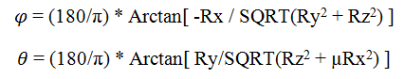
Signal Processing
Algorithms
Euler angles calculation:
Gyroscope: Integration of angular velocity over time.
Accelerometer: Multiplication with a (x,y,z) Direction Cosine Transformation Matrix.

Slide 38
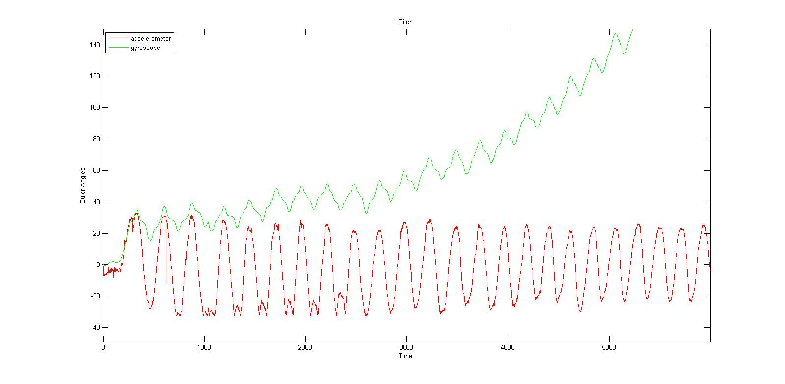
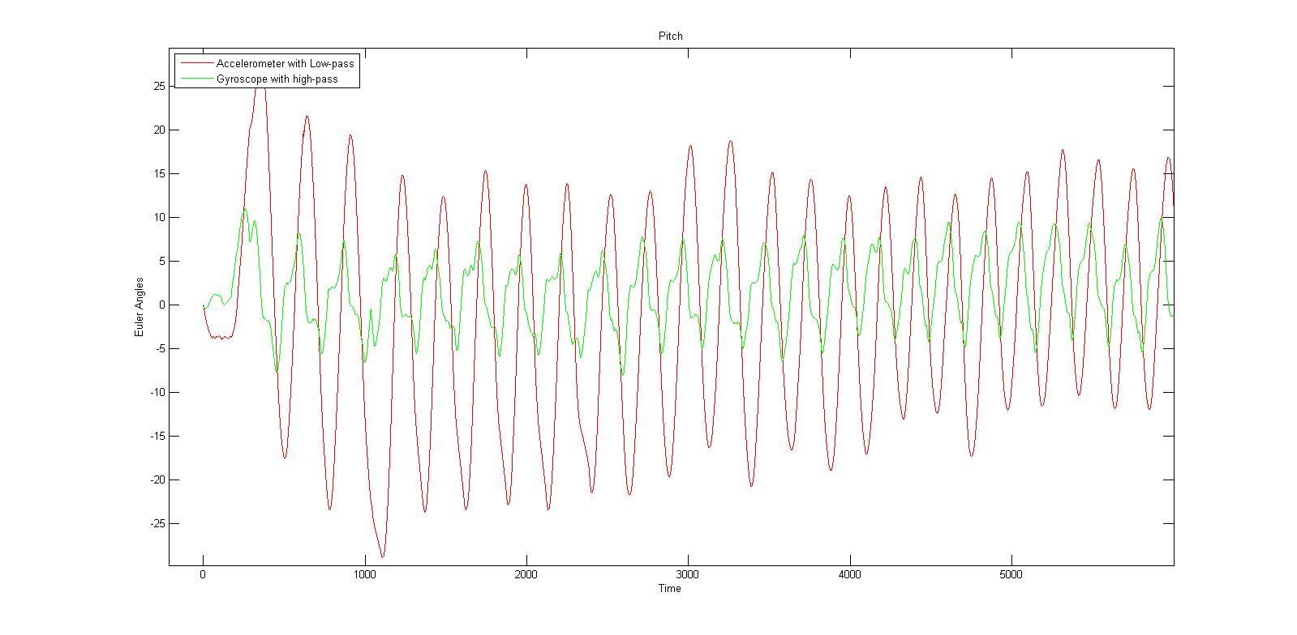
Signal Processing
Algorithms
Theta angle by Accelerometer and Gyroscope:
AFTER HIGH-PASS AND LOW-PASS FILTER
BEFORE FILTER

Slide 39
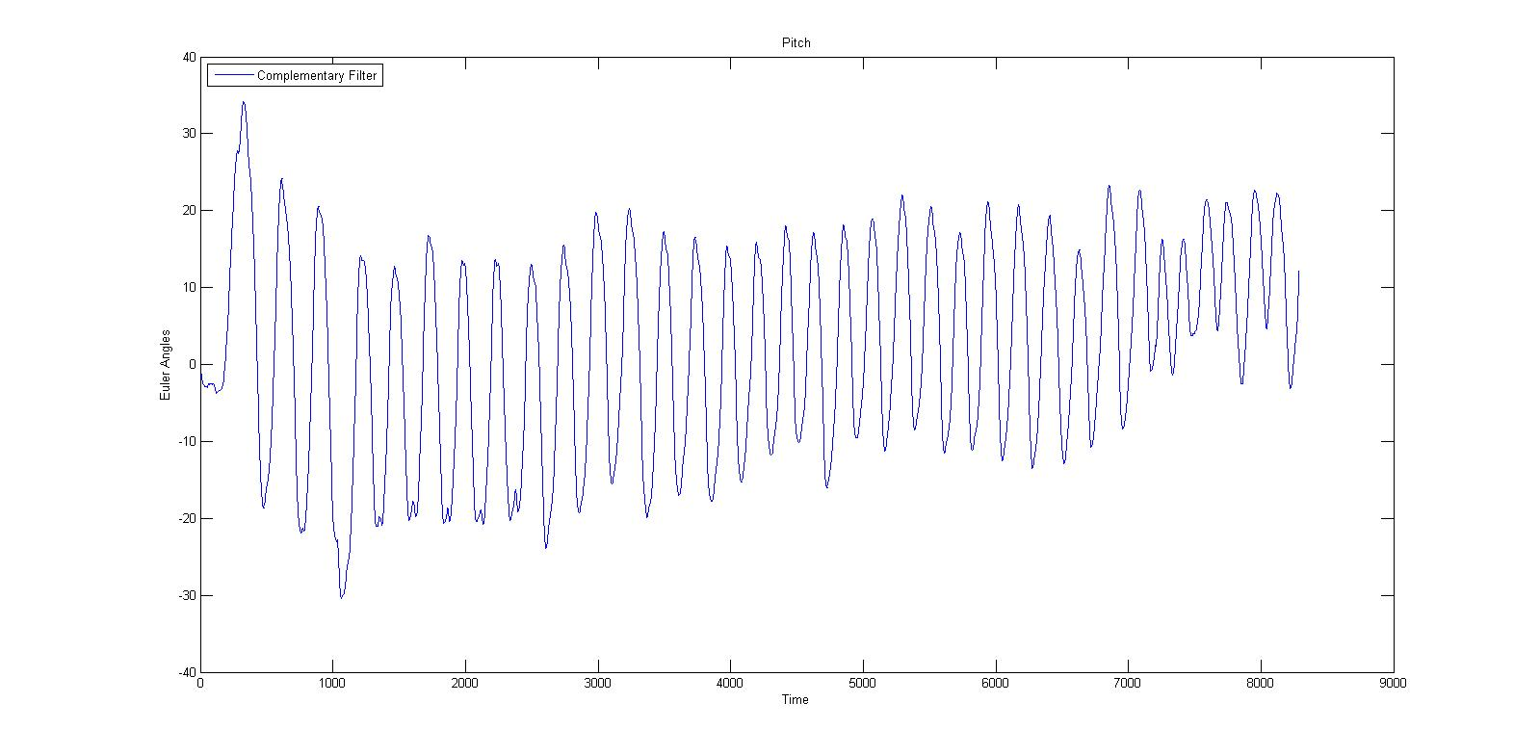
Signal Processing
Algorithms
Theta angle by Accelerometer and Gyroscope:
AFTER COMPLEMENTARY FILTER

Slide 40
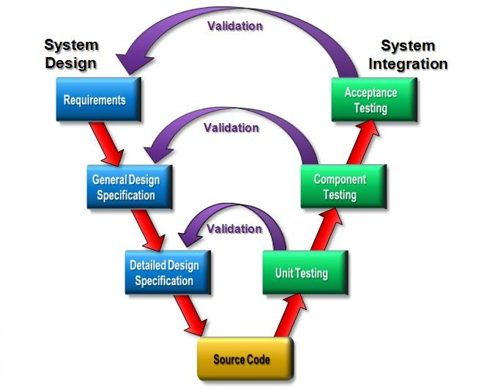
Result
Experiment
Test
Strategy

Slide 41
Result
Experiment
 | Project | FUFO | Start-Date | 28-Jul | Evaluation | OK
 | Buglist ST |  | End-Date | 20-Aug
 | No | Module Name | Number of bugs | Number of bug Fixed | Module status | Note
 | 1 | AOC | 7 | 7 | OK
 | 2 | FUFO | 3 | 3 | OK
 | 3 | AOP | 6 | 6 | OK
Function | Unit test |  |  |  | Unit test
 | Test case |  | Bug |  | Test case |  | Bug |  | Result
 | Plan | Actual | Plan | Actual | Plan | Actual | Plan | Actual
AOC | 65 | 63 | 7 | 8 | 55 | 53 | 6 | 6 | OK
FUFO | 30 | 27 | 3 | 2 | 25 | 27 | 2 | 3 | OK
AOP | 60 | 62 | 6 | 8 | 50 | 57 | 5 | 5 | OK

Slide 42
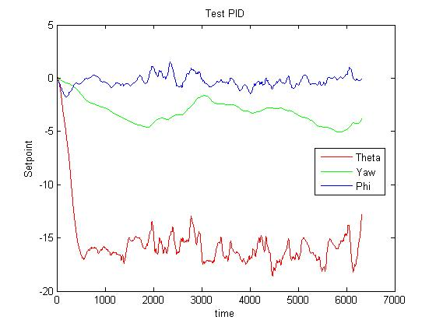
Results
Experiment
Indoor flight:

Slide 43
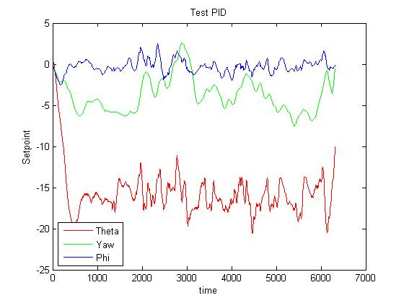
Results
Experiment
Outdoor flight:

Slide 44
Achievement
Conclusion
Successfully proved the correctness of the aforementioned algorithms.
Understand more about this flying platform for further improvement and development.

Slide 45
Future Improvement
Conclusion
Develop a higher response system.
Hold altitude in narrow and low area with precision of +-0.1 m
Hold a specified position on map or moving on a track.
Obstacle detection and avoidance.
CMOS camera's video transmission over long distance.
Object detection based on image processing.

Slide 46

www.themegallery.com
Thank You !
From FUFO team with love

